Slide 1
Transmission dynamics and host-parasite-vector relationships in rodent-borne Bartonella spp.
Background: Bartonella spp. is an erythrocytic bacterial pathogen of Malagasy rodents with different genotypes which could demonstrate unique transmission mechanisms.
Statistical Question: Is the occurrence of a given species of flea on Malagasy R. rattus related to (a) the rest of the ectoparasite community infesting the rat and/or (b) the locality in which the rat is trapped?
Mechanistic Question: How can we explain the prevalence of different genotypes of Bartonella spp. by age class in Malagasy Rattus rattus?
Acknowledgements: Christian and Sophia (readers); Gwen (presentation)
Cara Brook, University of Chicagp

Slide 2
Statistical Question: Is the occurrence of S. fonquerniei on Malagasy R. rattus related to (a) the indoor/outdoor locality in which the rat is trapped, (b) abundance of E. gallinacea, and (c) the abundance of X. cheopsis on the same rat?
Response Variable: pres/abs S. fonquerniei
Predictor Variables: abundance of
E. gallinacea (numeric); abundance
of X. cheopsis (factor);
indoor/outdoor locality (factor)
Family: “binomial”
Link: logit
Hypothesis: S. fonquerniei occurrence
is related to low abundance of
X. cheopsis & outdoor status locality
R code:
glm(pres/abs S. fonquerniei ~ abundance X. cheopsis + abundance E. gallinacea + indoor_outdoor, family=“binomial”, data = madarat)

Slide 3
Mechanistic Question: How can we explain the prevalence of different serotypes of Bartonella spp. by age class in Malagasy Rattus rattus?
S = susceptible rats
I = infectious rats
λ = force of infection;
σ = rate of waning immunity
λ
S
I
Bartonella phoceensis
prevalence
Force of Infection (days-1)
λ
S
I
Bartonella elizabethae
prevalence
σ
Force of Infection (days-1)
Age (days)
Age (days)

Slide 4
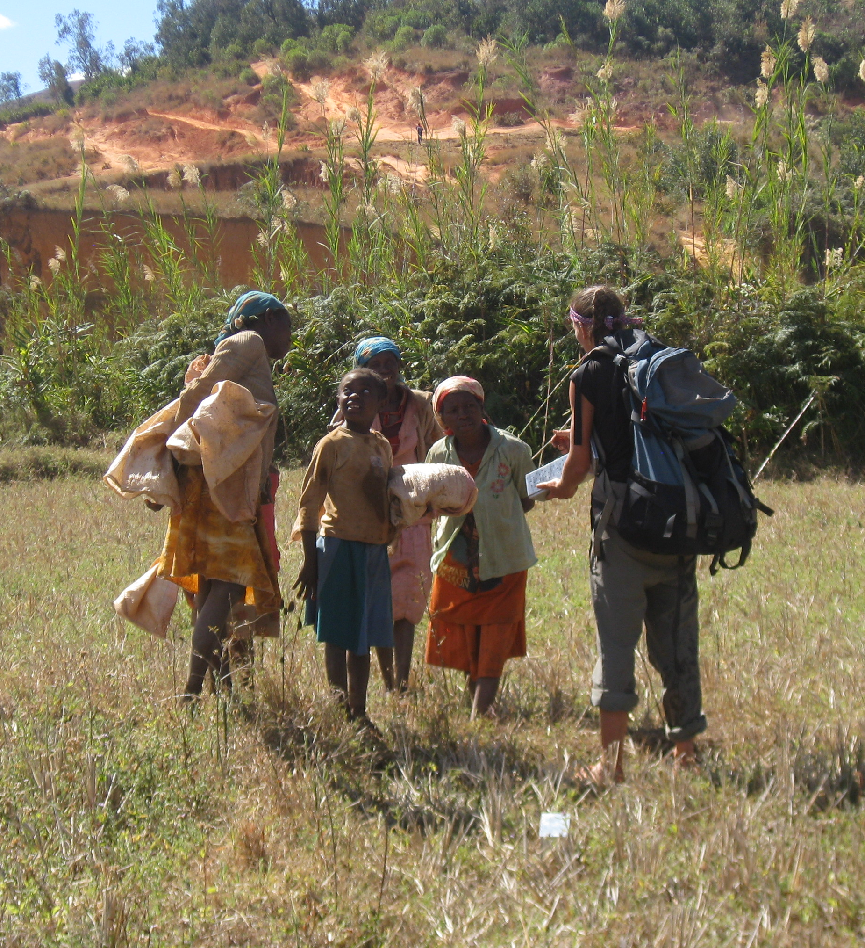
Next Steps:
Conduct further field studies in lowland regions of Madagascar to determine whether the distribution of B. elizabethae is limited to the highland range of S. fonquerniei
Conduct more thorough sampling of R. rattus ectoparasite community to augment data suggesting that Polyplax sp. lice may serve as a vector for B. phoceensis
Conduct serological tests on R. rattus blood to attempt to identify a whether Bartonella spp. negative rats are recovered or susceptible.
Fit relevant mechanistic transmission models to age-seroprevalence data.

Slide 5
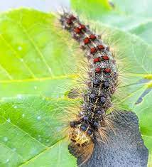
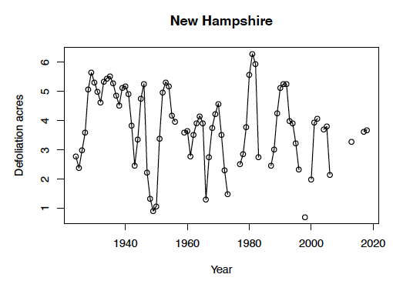
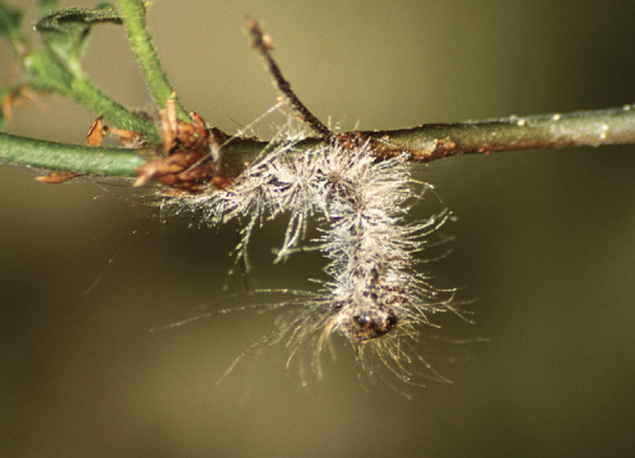
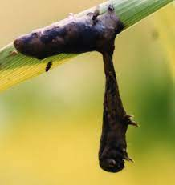
Investigating coinfections in the spongy moth-fungus-virus system
Background: The spongy moth, Lymantria dispar, is an invasive lepidopteran (family: Lymantriidae) that defoliates hardwood trees across North America. Its population dynamics are driven by epizootics (epidemics in animals) of two fatal, environmentally-transmitted pathogens: a fungus, Entomophaga maimaiga, and a baculovirus, Ld-nucleopolyhedrovirus. Coinfections are detected in nature, but we do not understand what factors drive the presence of coinfection, or how coinfections influence spongy moth population dynamics.
Statistical Question: What is the relationship between environmental factors (rainfall, relative humidity, temperature) and the presence of coinfections?
Mechanistic Question: How do coinfections drive spongy moth population dynamics?
Sophia Horigan, University of Chicago
S
F
V

Slide 6
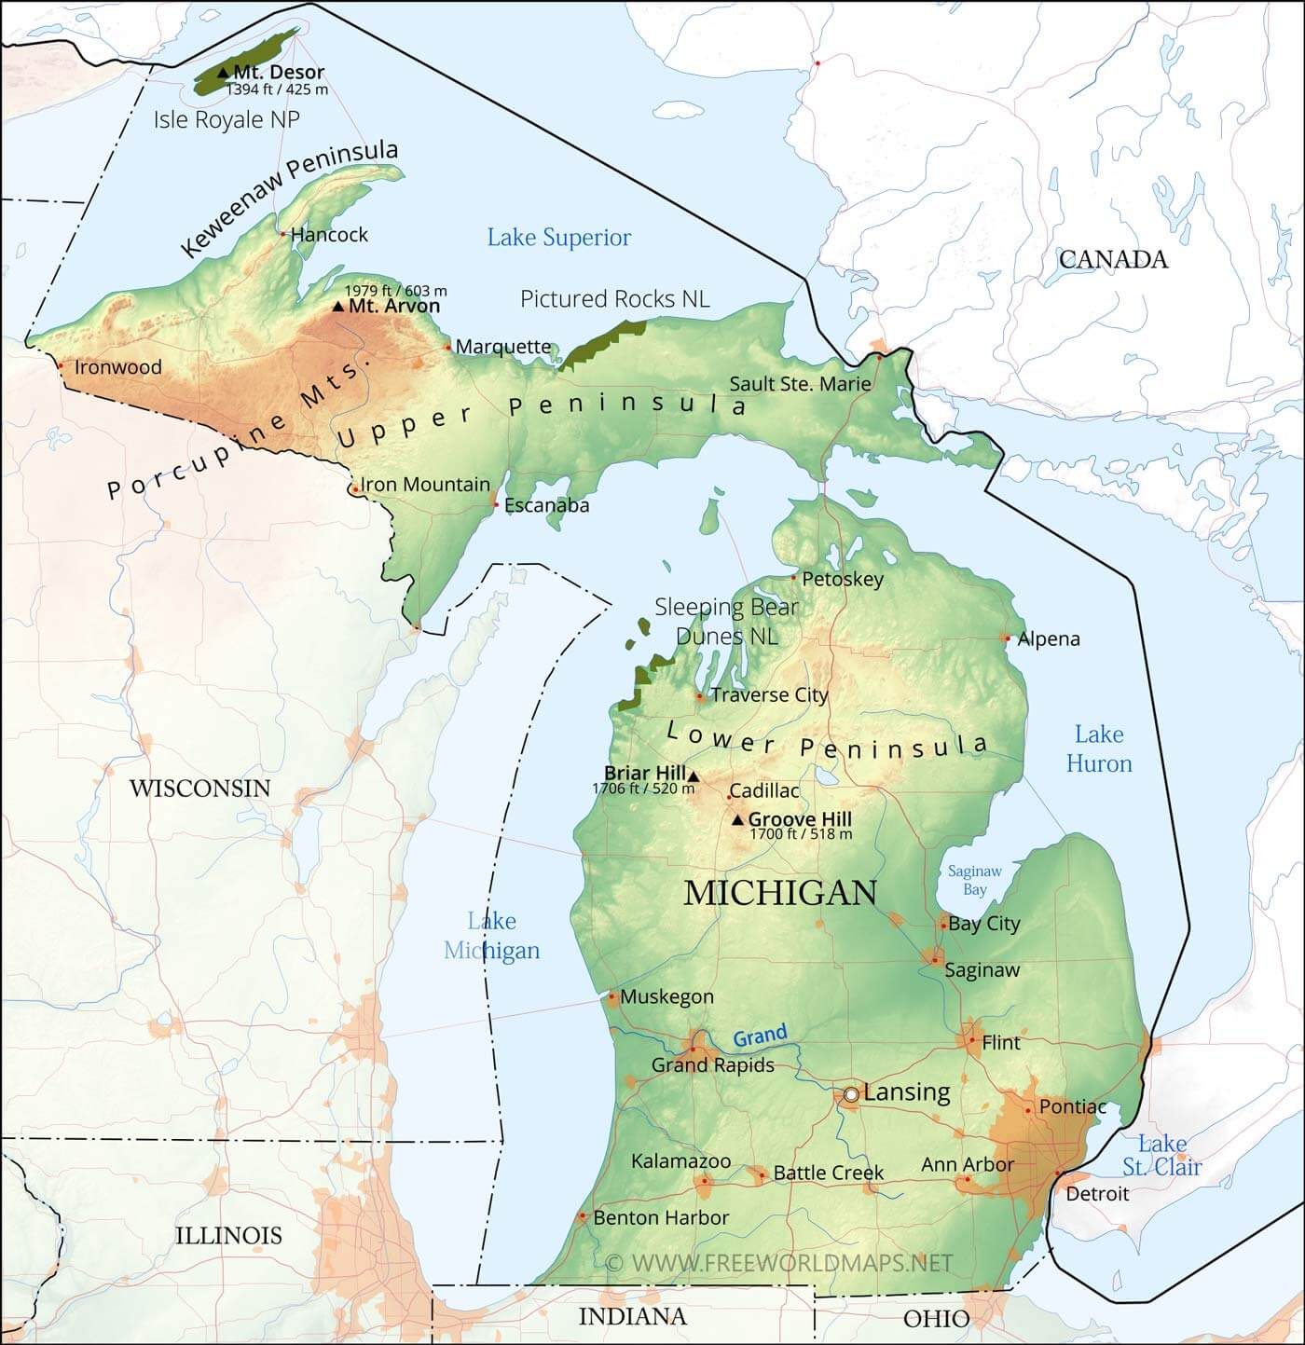
Statistical Question:
What is the relationship between environmental factors and the presence of coinfections?
Response Variable: cumulative number of coinfections in a population
Predictor Variable: temperature, relative humidity, rainfall, site
Family: “poisson”
Link: log
Hypothesis: Sites with higher rainfall, higher humidity, and moderate temperatures will have a higher number of cumulative coinfections.
R code:
glm(cum. # coinfections~rainfall + temperature + relative humidity + (1| site), family = “poisson”, data=infection.data)
1
2
3
4
6
5
7
Sophia Horigan, University of Chicago

Slide 7
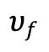
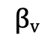
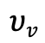
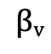
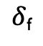
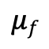
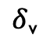
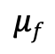
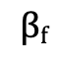
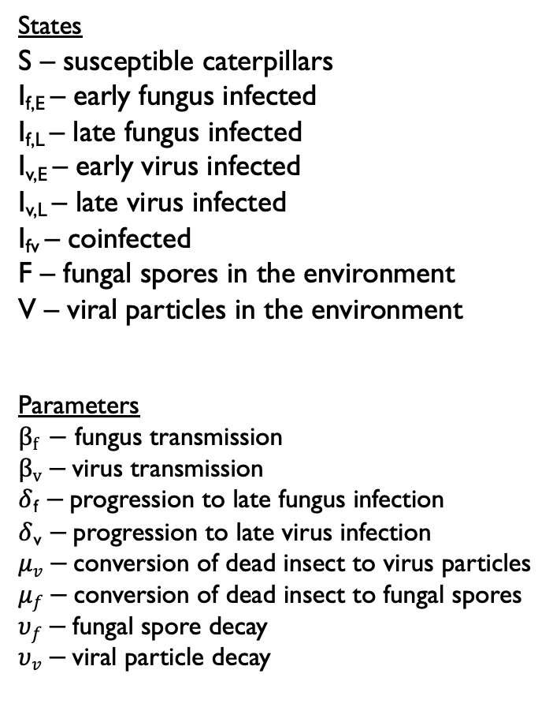
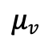
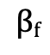
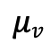
Mechanistic Question:
How do coinfections drive spongy moth population dynamics?
States
S – susceptible caterpillars
I_{f,E} – early fungus infected
I_{f,L} – late fungus infected
I_{v,E} – early virus infected
I_{v,L} – late virus infected
I_{fv} – coinfected
F – fungal spores in the environment
V – viral particles in the environment
Parameters
$βf −$ fungus transmission
$βv−$ virus transmission
$δ$_{f} $−$ progression to late fungus infection
$δ$_{v} $−$ progression to late virus infection
$μv−$ conversion of dead insect to virus particles
$μf−$ conversion of dead insect to fungal spores
$υf−$ fungal spore decay
$υv−$ viral particle decay
I_{f,E}
$δ$_{f}
I_{f,L}
$$μf$$
$$βf$$
$$υf$$
F
S
$$μf$$
$$βv$$
I_{fv}
$$βf$$
$$μv$$
V
$$υv$$
$$βv$$
I_{v,E}
I_{v,L}
$δ$_{v}
$$μv$$

Slide 8
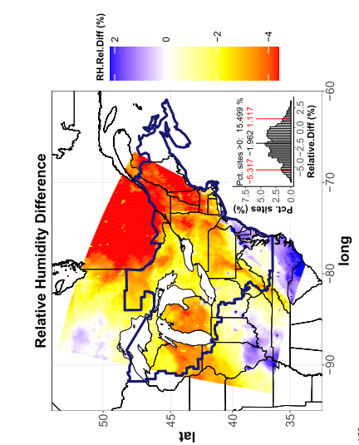
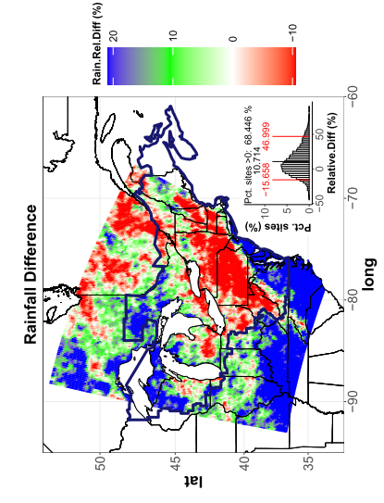
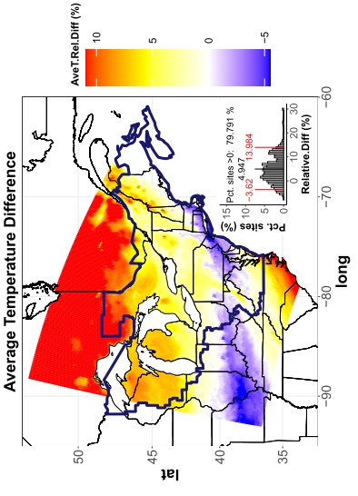
Investigating coinfections in the spongy moth-fungus-virus system
Next Steps:
Conduct field sampling at all sites for at least two more years to get infection data across a range of annual weather conditions.
Fit the mechanistic model to both the field and experimental data.
Extend the model to long-term dynamics by incorporating spongy moth reproduction and pathogen overwintering dynamics.
Use the long-term model to predict the future of spongy moth populations under climate change.
Sophia Horigan, University of Chicago

Slide 9
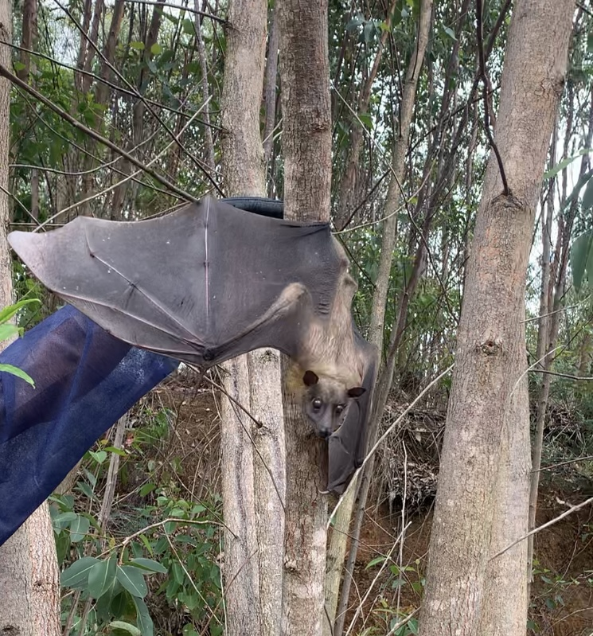
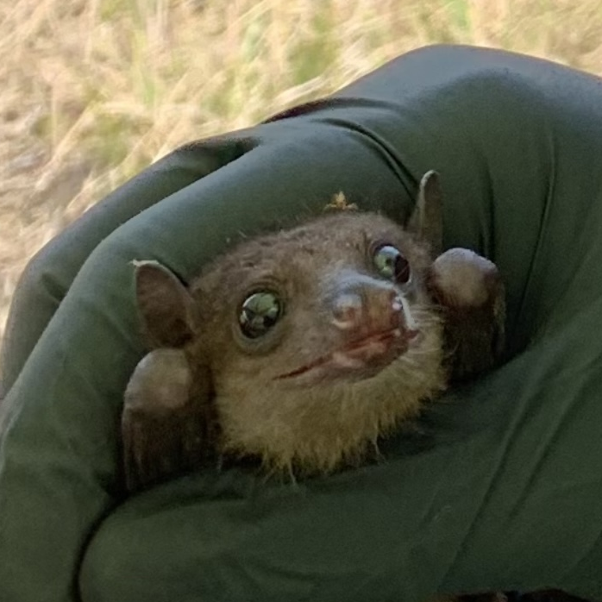
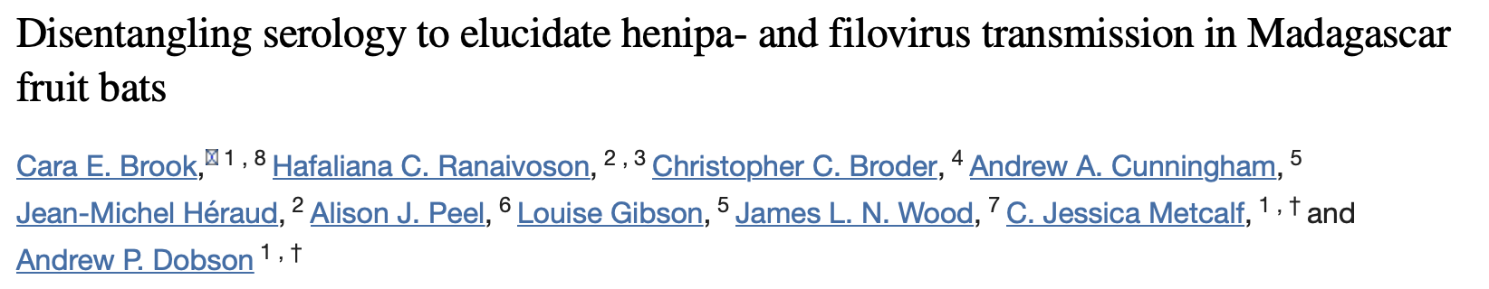
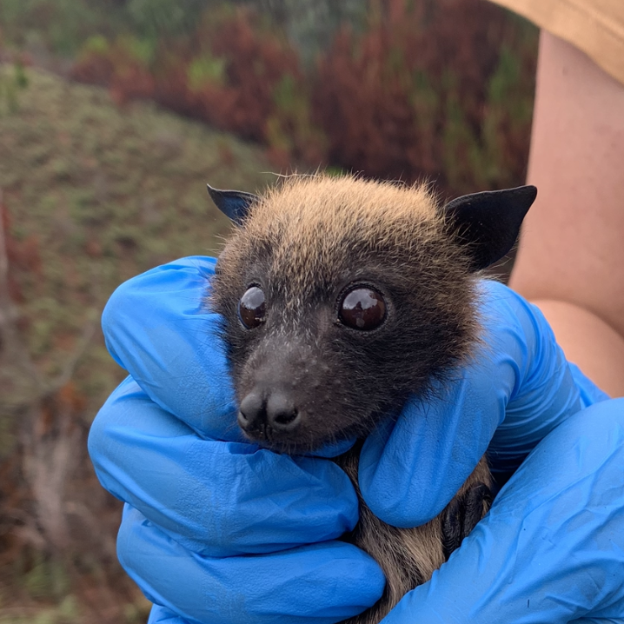
Age mediated viral shedding in Malagasy fruit bats
Background: Previous work in our lab has shown that age class and sex of bats impacts seroprevalence for henipaviruses and filoviruses. However, we do not know how viral shedding in bats from active infections impact age-seroprevalence.
Statistical question: How does age class drive viral load in Malagasy fruit bats?
Mechanistic question: How does viral shedding differ between juvenile and adult Malagasy fruit bats?
Acknowledgement to people who have evaluated these models: DAIDD 2021 (mechanistic model), Cara Brook, Sophia Horigan (statistical model)
Gwen Kettenburg, UChicago

Slide 10
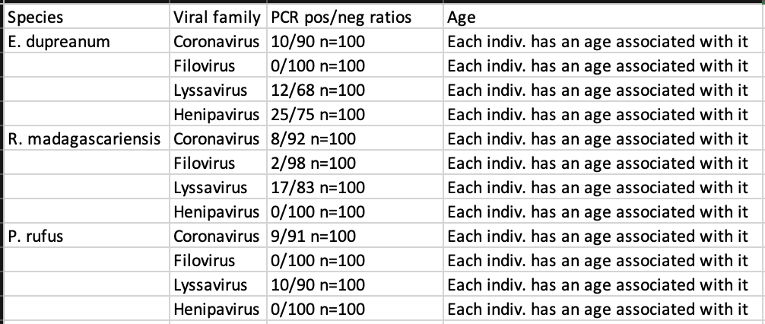
Statistical question: How does age class of Malagasy fruit bats mediate viral load?
Hypothesis: Adult bats shed more virus than juvenile bats
Response variable: presence/absence of coronavirus, filovirus, lyssavirus, and/or henipavirus
Predictor variable: age, bat species, virus family
Distribution: “binomial”
Linker: logit
R function: glmer(presence/absence virus~age+(1|bat/virus), family=“binomial”, data=mada.bat.age.virus.shedding
Nest virus family in bat fam as rndm effect for glmer

Slide 11
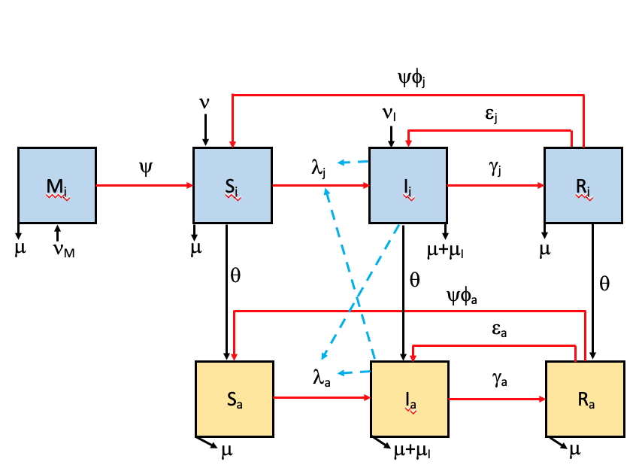
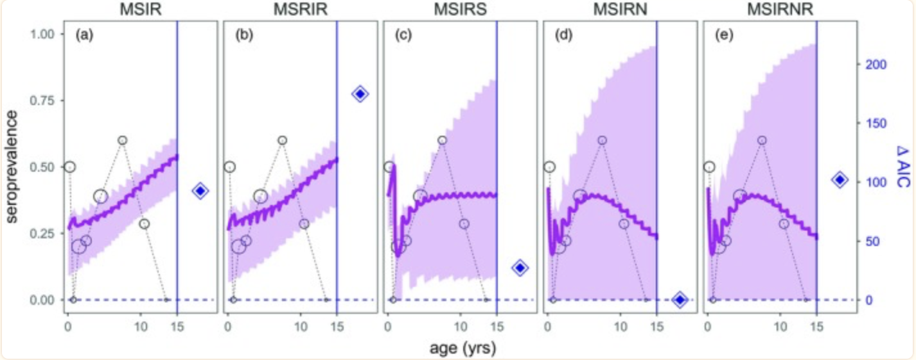
Mechanistic question: How does viral shedding differ between juvenile and adult Malagasy fruit bats?
Parameter | Description
M | Maternally immune
S | Susceptible
I | Infectious/infected
R | Recovered
Parameter | Description
ν | Births
ν_{M} | Births from maternally immune adults
ν_{I} | Births from infected/infectious adults
μ | Deaths
μ_{I} | Deaths from infection
λ_{j} | Virus transmission rate in juveniles
λ_{a} | Virus transmission rate in adults
γ_{j} | Recovery rate in juveniles
γ_{a} | Recovery rate in adults
ψ | Maternal antibody waning
N_{j} | Juvenile population size
N_{a} | Adult population size
φ_{j} | Antibody waning, susceptible again in juveniles
φ_{a} | Antibody waning, susceptible again in adults
ε_{j} | Persistently infected or latent in juveniles, infected->infectious or latent->infectious
ε_{a} | Persistently infected or latent in adults, infected->infectious or latent->infectious
θ | Aging rate from juvenile to adult
Brook et. al 2019
Notes:
Juvenile bats are born at birth rate (ν) and are either maternally immune ν_{M}, infected from mother ν_{I}, or susceptible ν. Maternal antibodies could wane at rate ψ, making them susceptible S_{j}. They may become infectious I_{j} through henipavirus transmission rate λ_{j} and may recover through rate γ_{j}. Juveniles that are infected but latent may transition back to infectious through a rate of ε_{j}. Infected juveniles could also clear infection and have antibodies wane through rate ψφ_{j} and could become susceptible again S_{j}. Juvenile bats at any class can become adults at their matching stages at time θ. Adult bats can start off as susceptible S_{a} and may become infected/infectious at rate λ_{a}, and recover R_{a} at rate γ_{a}. They can go from being infected and latent back to infectious at rate ε_{a}. Adults can also clear infection and have antibodies wane through rate ψφ_{a} and could become susceptible again S_{a}. Individuals may leave compartments at any death rate μ or through disease induced mortality rate μ_{I}. Movement from susceptible S to infected/infectious I is driven by force of infection in both age classes.

Slide 12
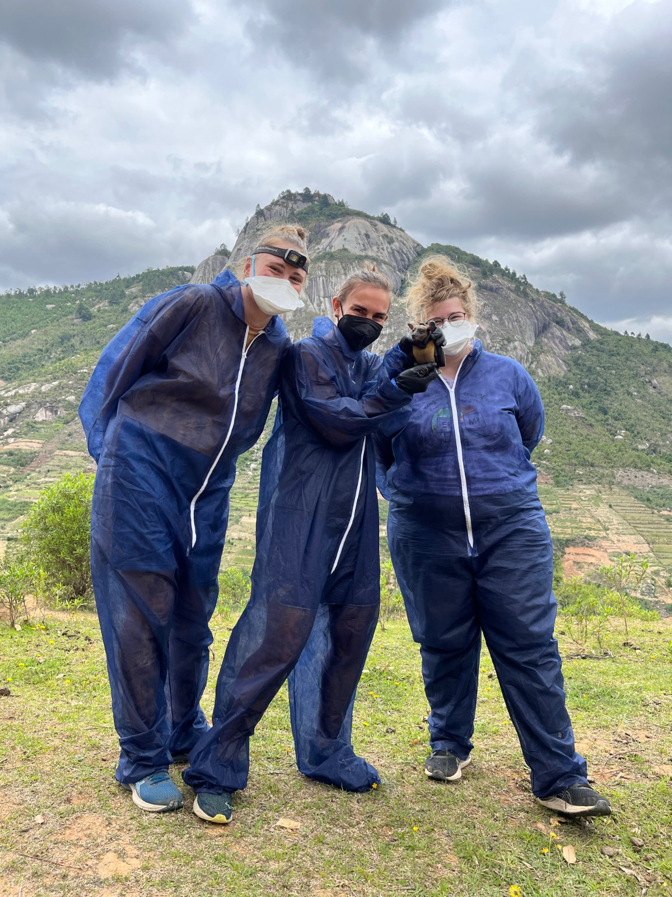
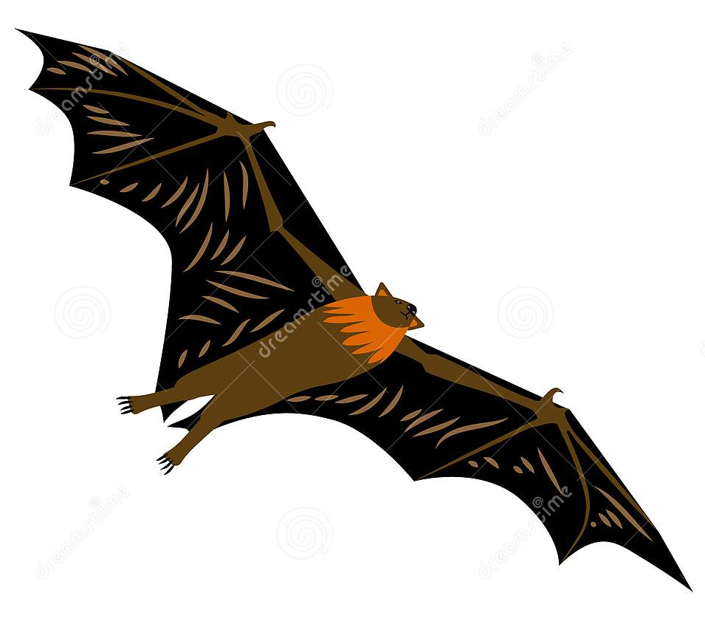
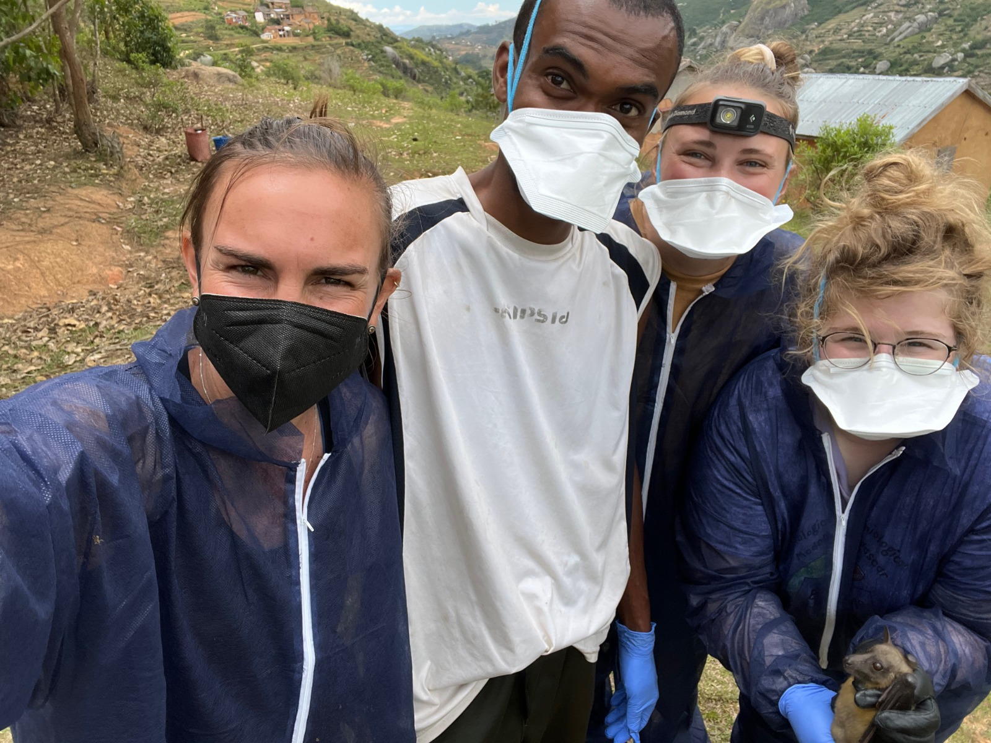
Next steps:
Generate family level PCR data for coronaviruses, lyssaviruses, filoviruses, henipaviruses (presence/absence data)
Use Sanger sequencing from positive hits to design specific virus primers
Generate qPCR data for above viruses (quantitative data)
Fit relevant mechanistic model to relevant age-qPCR data for each viral family.

